Slide 1
Starter
Why are rubbish dumps thought to be a bad thing?
What does recycling mean?

Slide 2
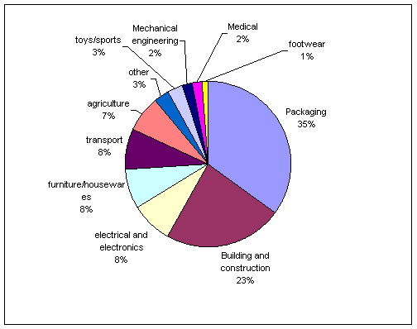
Uses of plastics - Statistics

Slide 3
Types of Plastic
 | PET | Polyethylene terephthalate - Fizzy drink bottles and oven-ready meal trays.
 | HDPE | High-density polyethylene - Bottles for milk and washing-up liquids.
 | PVC | Polyvinyl chloride - Food trays, cling film, bottles for squash, mineral water and shampoo.
 | LDPE | Low density polyethylene - Carrier bags and bin liners.
 | PP | Polypropylene - Margarine tubs, microwaveable meal trays.
 | PS | Polystyrene - Yoghurt pots, foam meat or fish trays, hamburger boxes and egg cartons, vending cups, plastic cutlery, protective packaging for electronic goods and toys.
 | OTHER | Any other plastics that do not fall into any of the above categories. - An example is melamine, which is often used in plastic plates and cups.

Slide 4
Percentage that can be recycled
About 7% of all household waste is plastic.
Annually, 3 million tonnes of plastic rubbish are produced.
57% of litter found on beaches is plastic.
In 2001 only 7% of all plastic was recycled. Is this the case in your household?

Slide 5
Why recycle plastic?
Conservation of non-renewable fossil fuels - Plastic production uses 8% of the world's oil production.
Reduced consumption of energy.
Reduced amounts of solid waste going to landfill.
Reduced emissions of carbon-dioxide (CO₂), nitrogen-oxide (NO) and sulphur-dioxide (SO₂).

Slide 6
How are polymers recycled?
Mechanical recycling of plastics refers to processes which involve the melting, shredding or granulation of waste plastics.
Plastics must be sorted prior to mechanical recycling.
At the moment in the UK most sorting for mechanical recycling is done by trained staff who manually sort the plastics into polymer type and/or colour.

Slide 7
More
Following sorting, the plastic is either melted down directly and moulded into a new shape, or melted down after being shredded into flakes and than processed into granules called regranulate.

Slide 8
What can we do?
An increasing number of local authorities are now providing plastics collection services. Research by RECOUP has shown that local authorities can achieve cost-effective high-achieving plastics collection systems by integrating plastic bottle collection with other recyclable materials. For example, Daventry District Council introduced such a system in 1998 and has been able to increase recycling rates from 12% to nearly 50%.
In Adur, West Sussex, and Milton Keynes in Buckinghamshire, plastic bottles and polystyrene are collected through 'blue box' schemes, where residents place recyclable materials in a separate box for sorting by the refuse collectors at the kerbside. Plastics and other materials are sorted into a compartmentalised vehicle, then taken to the Materials Reclamation Facility (MRF) for final sorting before transport to reprocessing plants.

Slide 9
This powerpoint was kindly donated to www.worldofteaching.com
http://www.worldofteaching.com is home to over a thousand powerpoints submitted by teachers. This is a completely free site and requires no registration. Please visit and I hope it will help in your teaching.

